Slide 1
University Outcomes
Understanding Key Performance Indicators for Highest Ranked Universities
Margaret Ulrich
Jatin Patel
Nimisha Patel

Slide 2
Data Sources

Slide 3
Data cleaning

Slide 4

Problem Statement
M - College ranking Vs. Graduation rate
M - College ranking Vs. Retention rate
J – Geo dispersion of colleges
J - College ranking Vs. SAT/ACT/Acceptance rate
N - College ranking Vs. Tuition rates
N - College ranking Vs SAT/ACT Scores

Slide 5
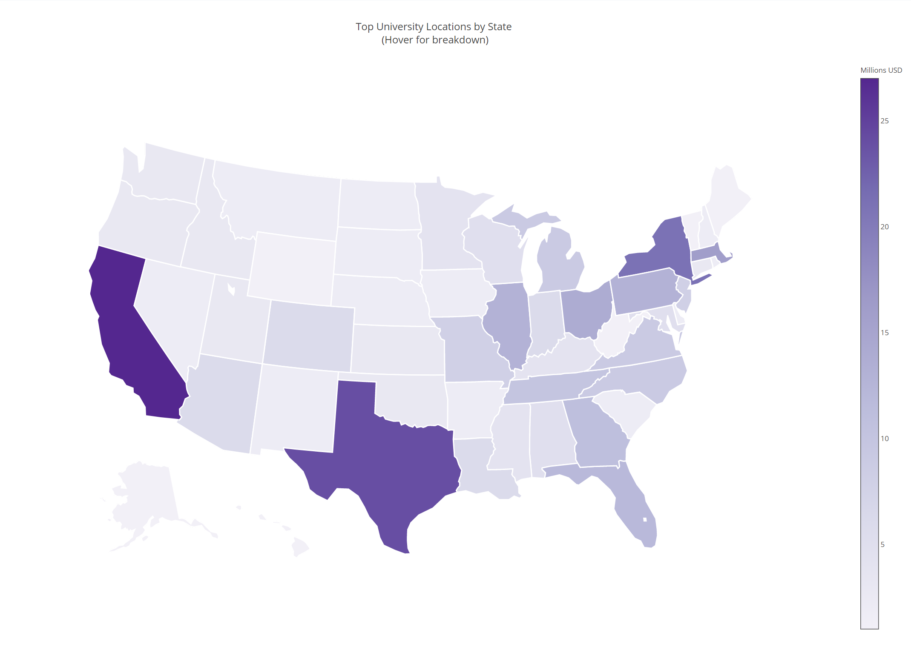
Top Ranked Colleges by the States
Analysis:
E and NE corridor has a higher concentration of top ranked colleges due to Financial and Industrial business.
California is leading in the West due to Silicon Valley.
Texas seems to have a higher concentration possibly due to Oil & Gas industry.
Conclusion: Industries play significant role in making of top colleges.

Slide 6
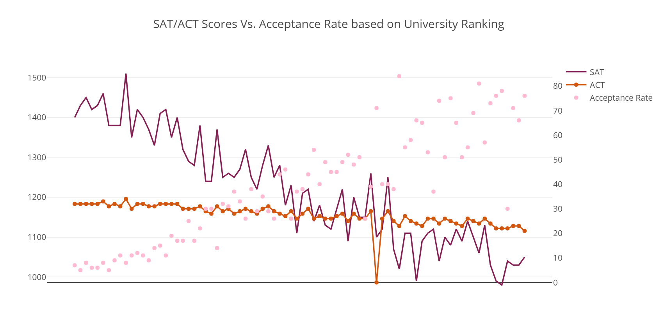
SAT/ACT Scores vs. Acceptance Rate by Top Colleges
Analysis:
Higher the college ranks, higher the SAT/ACT requirement thus lower the acceptance rate.
Lower the college rank, lower the SAT/ACT requirement thus higher acceptance rate.
Conclusion: SAT/ACT scores are inversely proportional to acceptance in the higher ranking colleges..

Slide 7
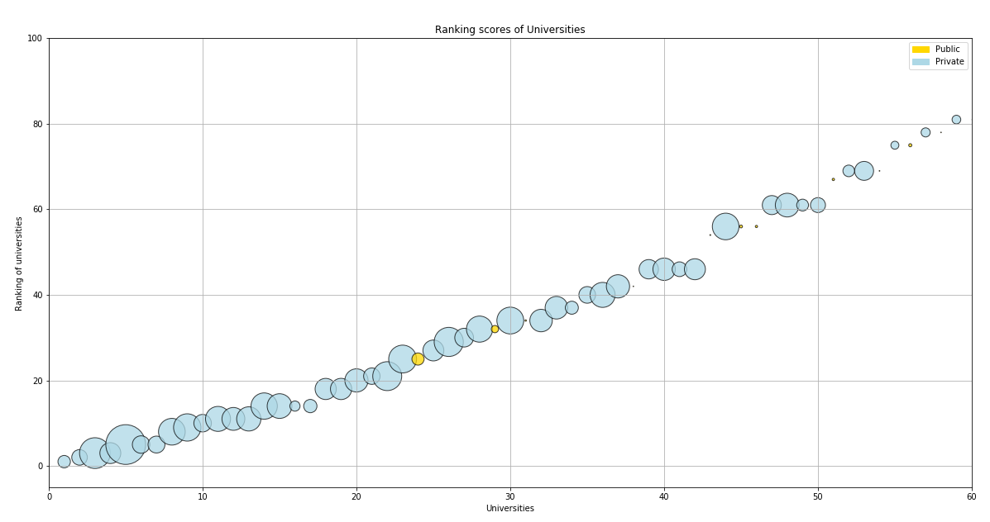
College Ranking Vs Tuition Rates
Analysis:
Trend of higher tuition and ranking
Public Colleges have low tuition
Less no of Private colleges
After a peak no linear pattern seen
Conclusion: Higher tuition in top 50 universities would be justifiable.

Slide 8
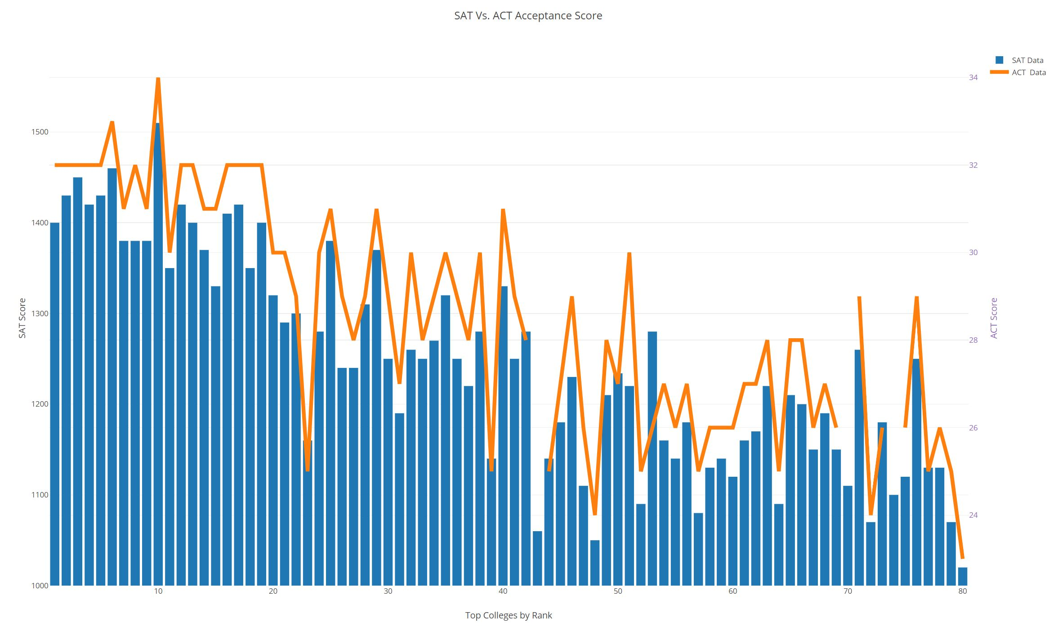
College Ranking Vs SAT/ACT Scores
Analysis:
Clear pattern seen for high SAT and ACT scores and ranking
SAT scores of 1375 and up is required for the top 10 colleges
ACT scores of 32 and up is required for top 10 colleges
Some colleges consider ACT scores more favorably than SAT scores
Some top ranked universities clearly show lower SAT/ACT requirements.
Other parameters are considered in ranking of top colleges.
Other parameters may include, course work, research grants, internship and job placements.
Conclusion: Top 10 colleges consider SAT and ACT equally.

Slide 9

Conclusion/Summary
Industries play significant role in making of top colleges.
SAT/ACT scores are inversely proportional to acceptance in the higher ranking colleges
Higher tuition in top 50 universities would be justifiable
Top 10 colleges consider SAT and ACT equally

Slide 10
Q & A

